Slide 1

City of Des Moines
Self-Supported Municipal Districts
& Sanitary Sewer Enterprise
December 2, 2019

Slide 2
Self-Supported Municipal Improvement Districts

Slide 3
SSMID Terms

Slide 4
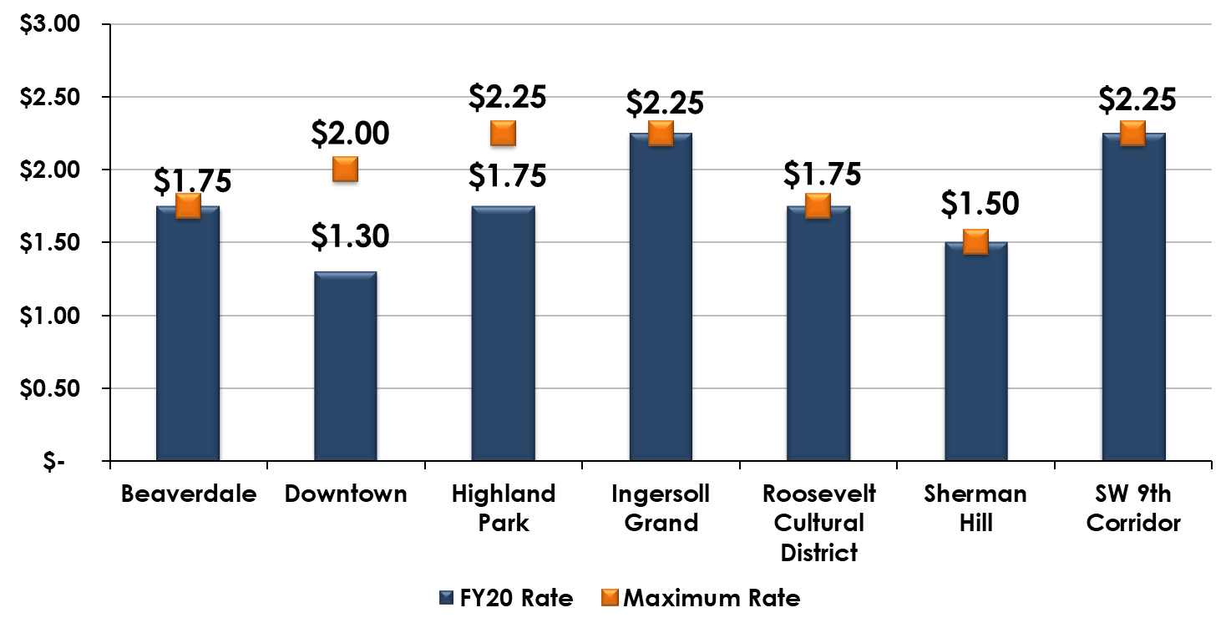
SSMID Levy Rates

Slide 5
SSMID Budget Processes

Slide 6
SSMID Financial Data

Slide 7
SSMID Financial Data

Slide 8
Downtown
Operation Downtown Fiscal Year 2021 Budget

Slide 9
Ingersoll Grand
Fiscal Year 2021 Budget

Slide 10
SW 9th Corridor
Fiscal Year 2021 Budget

Slide 11
Questions

Slide 12
Sanitary Sewer
Enterprise

Slide 13
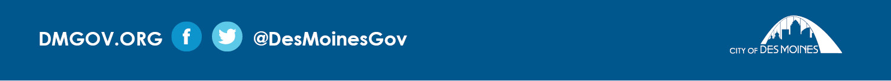
Sanitary Sewer
Established to provide funding for:
Operation and maintenance
Planning and design for capital construction projects
Compliance with federal and state laws and regulations

Slide 14
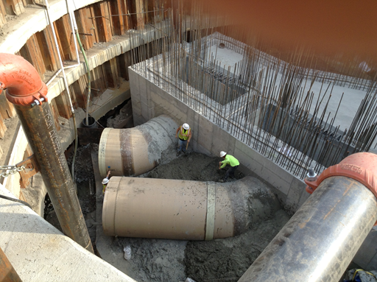
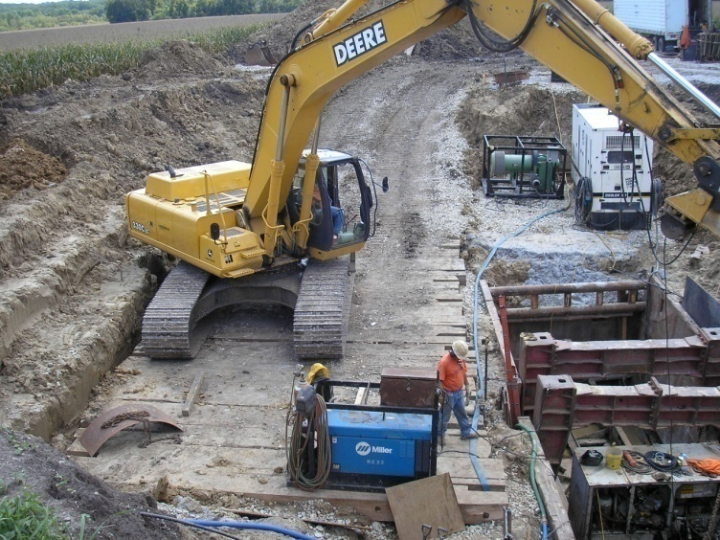
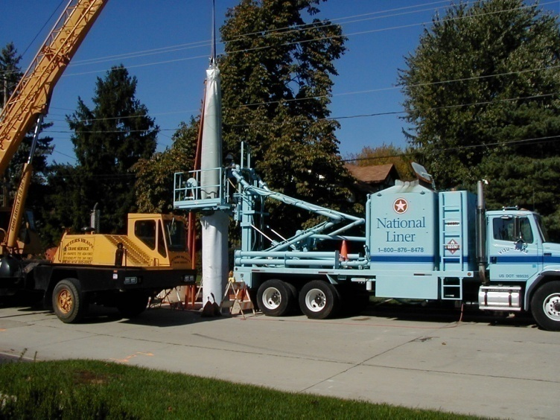
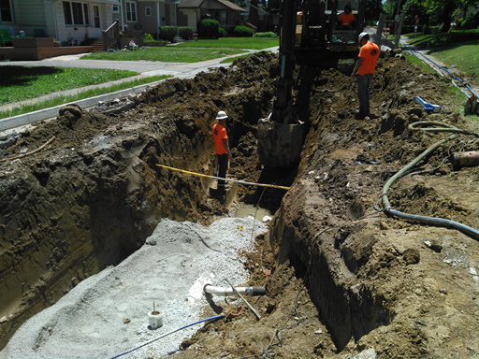
Sanitary Sewer Enterprise
Long Term Control Plan/WRA Projects
Connection Fee Program
Sewer Lining Program
City-Wide Sewer Program

Slide 15
Sanitary Sewer Personnel
52.0 Full Time Equivalents FT
  Sanitary Sewer Maintenance and Repair: 42.5
  Project Management/ Engineering/ Billing: 3.0
  Pump Station Operations: 6.5
15

Slide 16
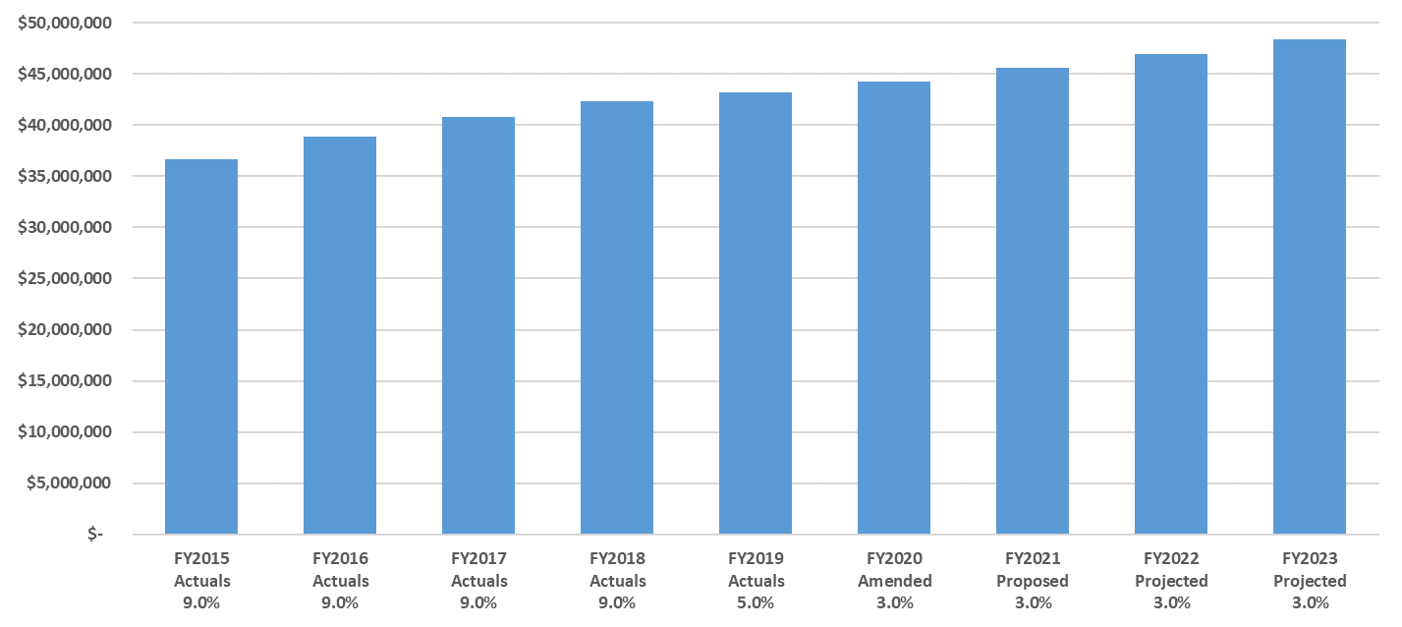
Sanitary Sewer Operating Revenue
The 3% rate increases in FY21 and FY22 have been approved
16

Slide 17
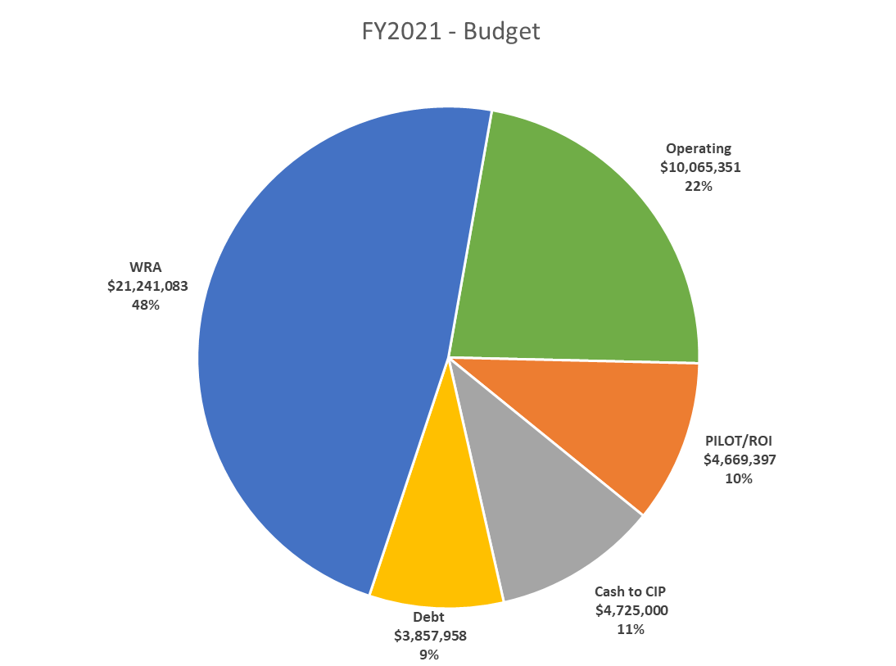
17

Slide 18
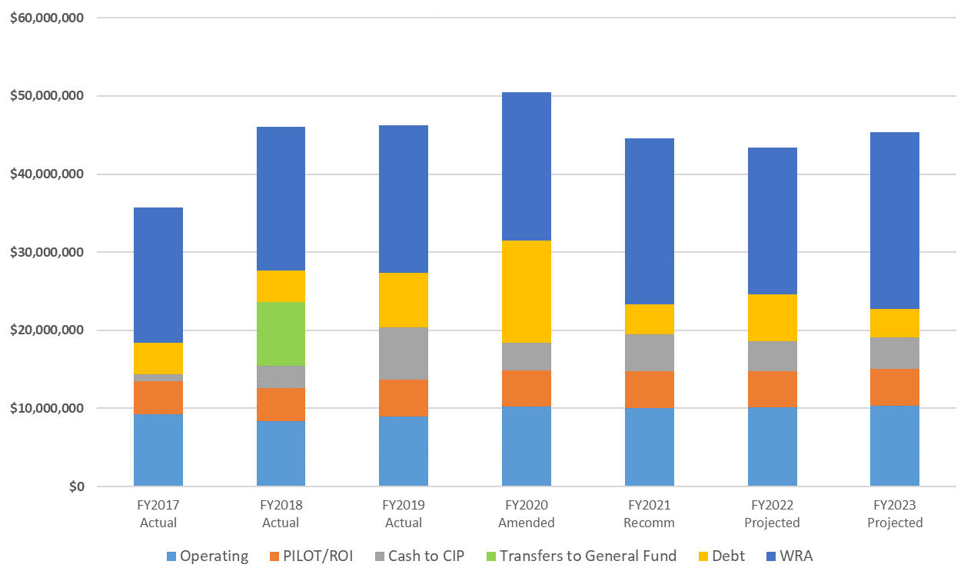
Sanitary Sewer Budget
18

Slide 19
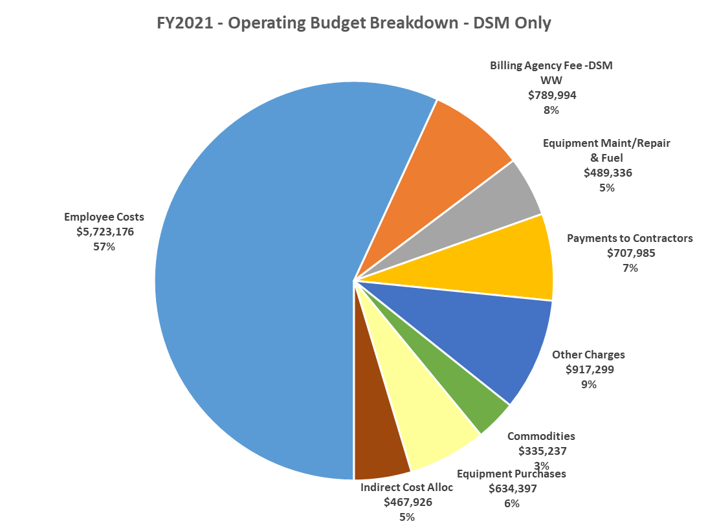
Total
$10,065,351
19

Slide 20
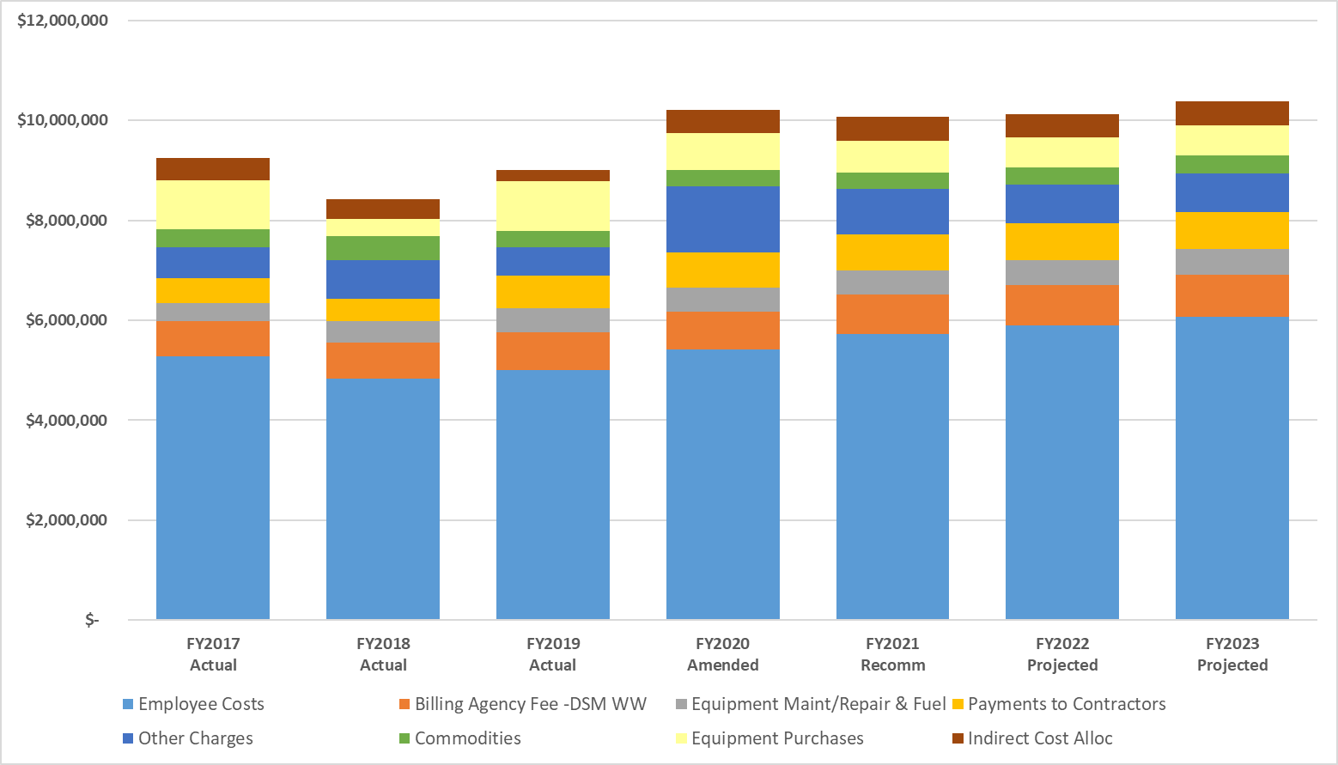
Operating Budget – DSM Only
20

Slide 21
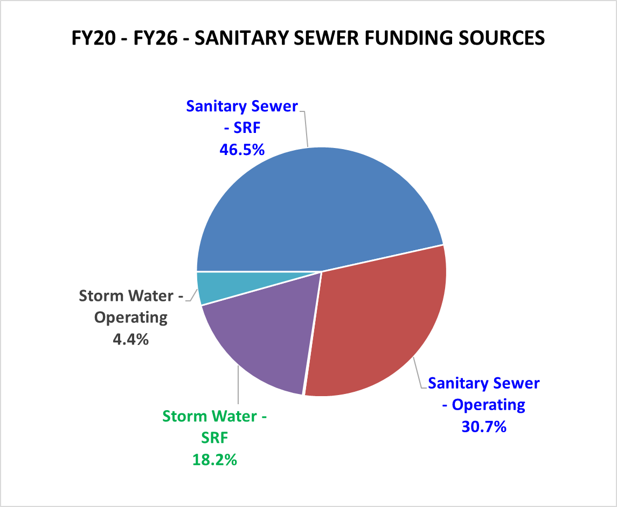
21

Slide 22
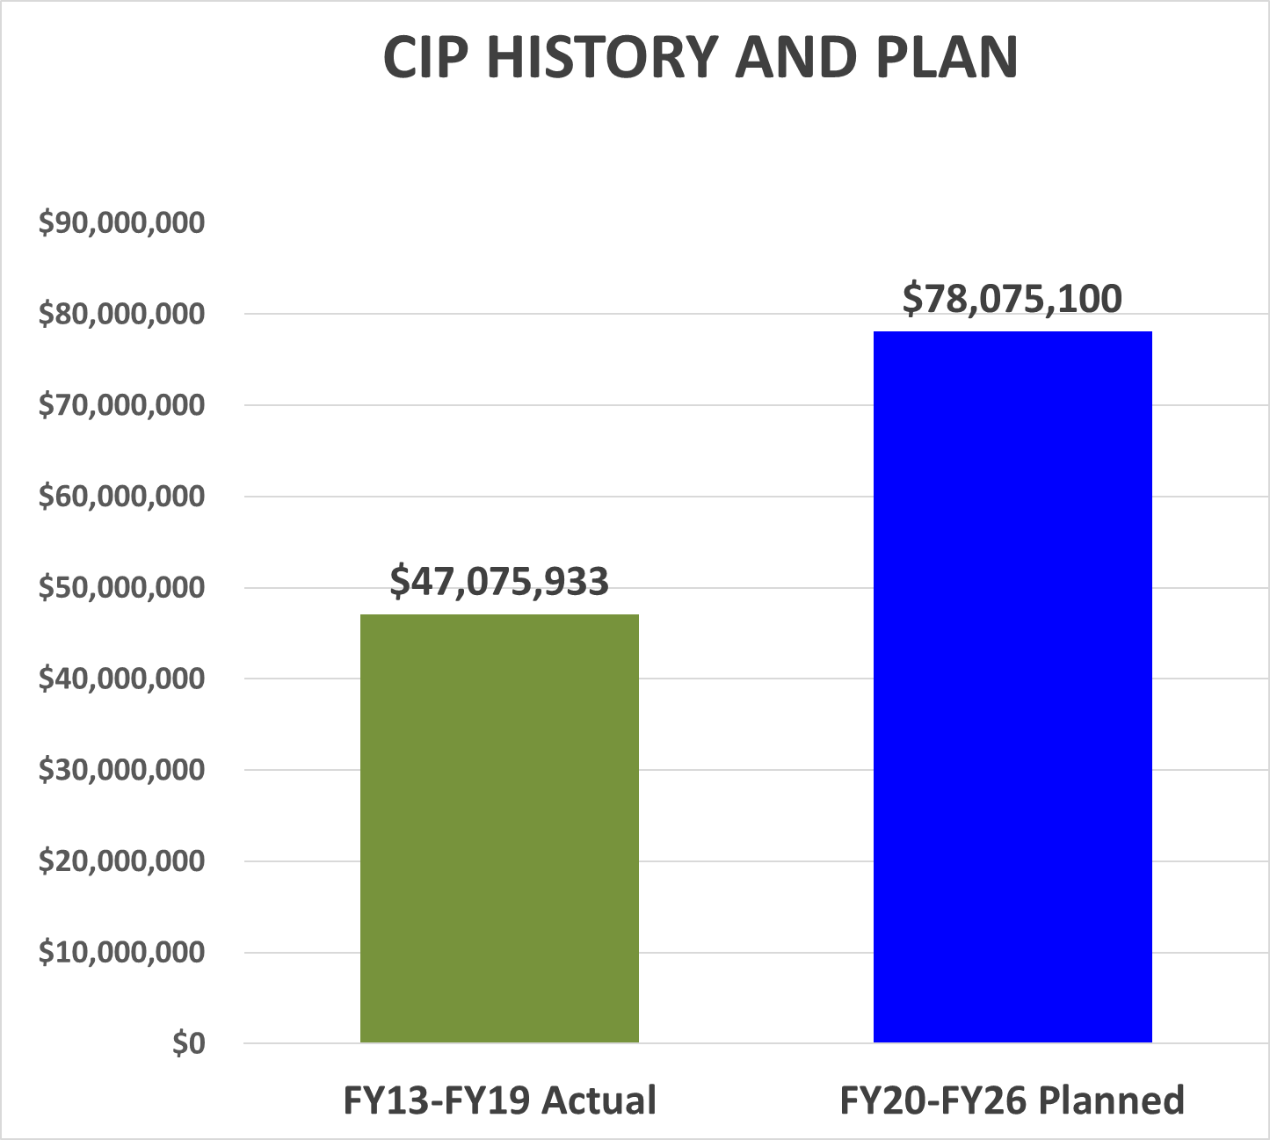

Slide 23
23

Slide 24
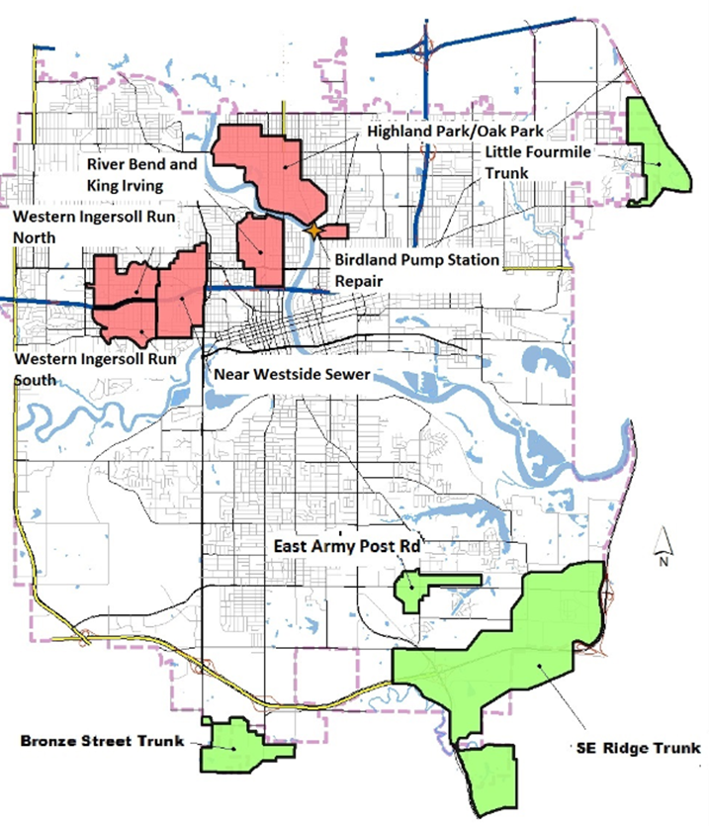
Sanitary Sewer CIP Projects
FY20-FY26 PLAN
Separation Projects - $86 Million
Expansion Projects - $6 Million
24

Slide 25
Little Four Mile Trunk Sanitary Sewer

Slide 26
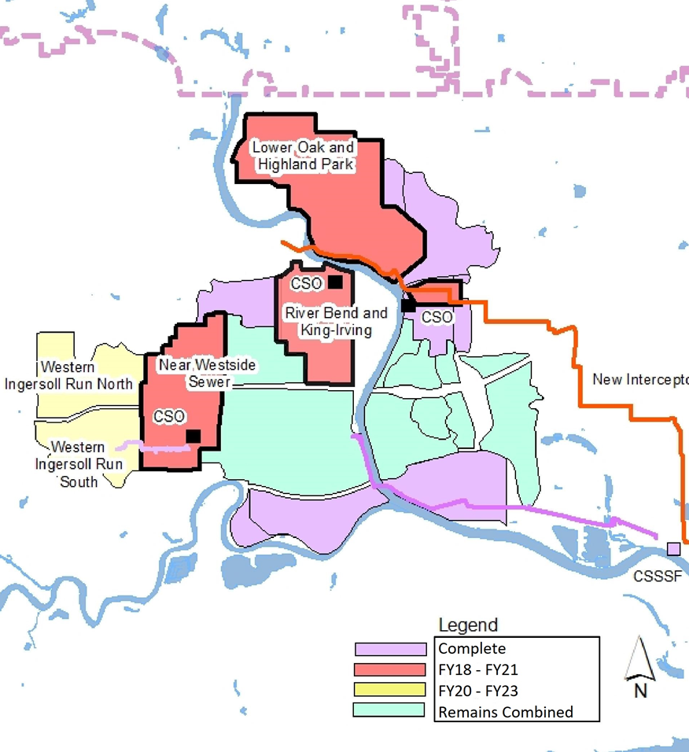
Long Term Control Plan
Consent Decree deadlines for CSO elimination:
2nd Ave/Franklin Ave 12/31/2020
Birdland Pump Station
12/31/2023
22nd St./High St.
12/31/2023
26

Slide 27
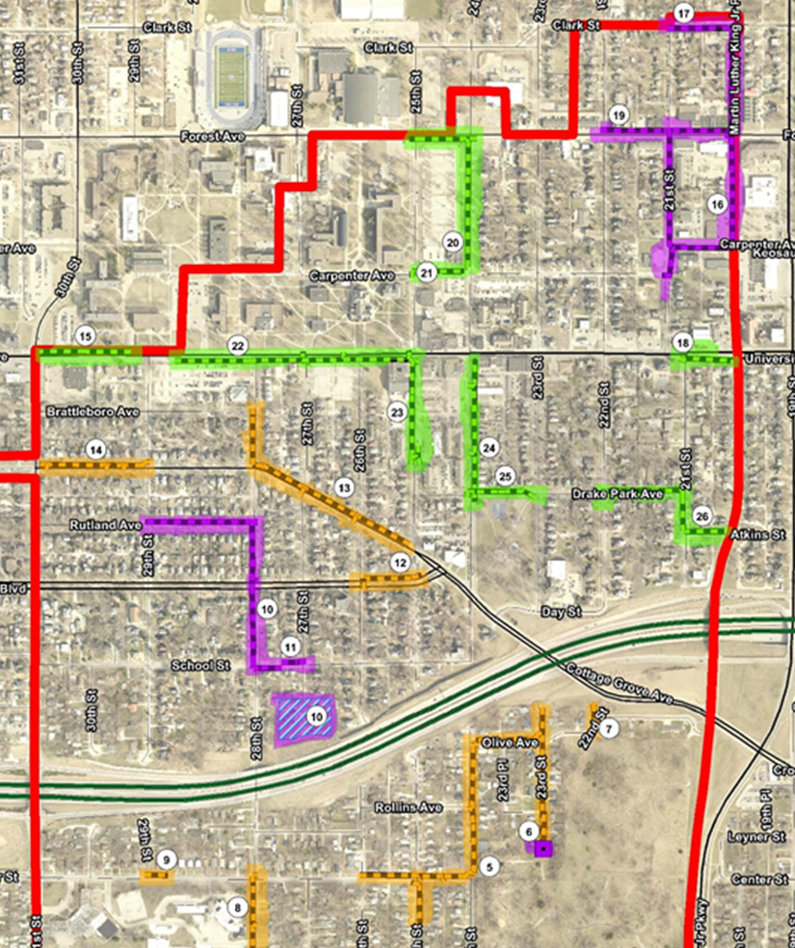
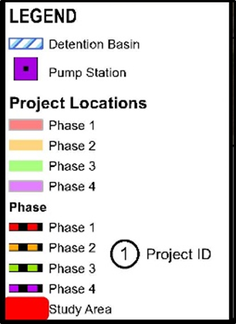
Near West Side
Sewer Separation
27

Slide 28
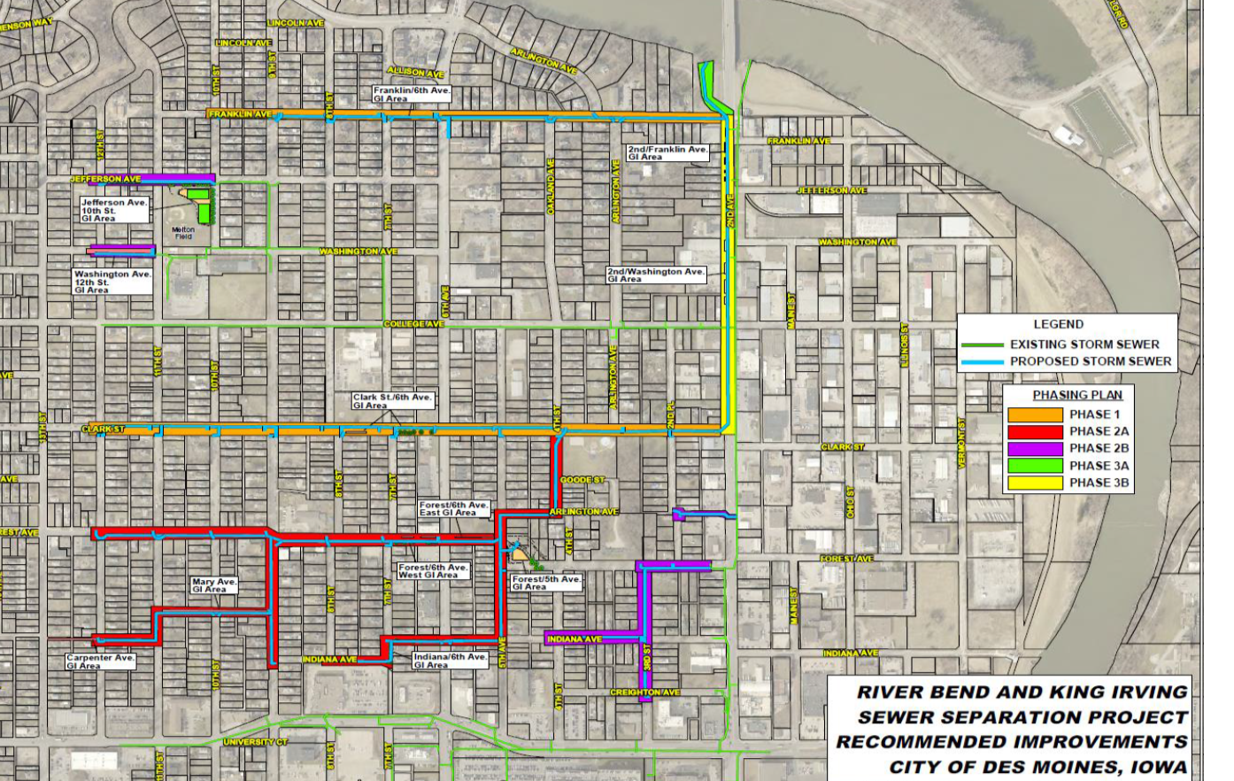
River Bend King Irving Separation
28

Slide 29
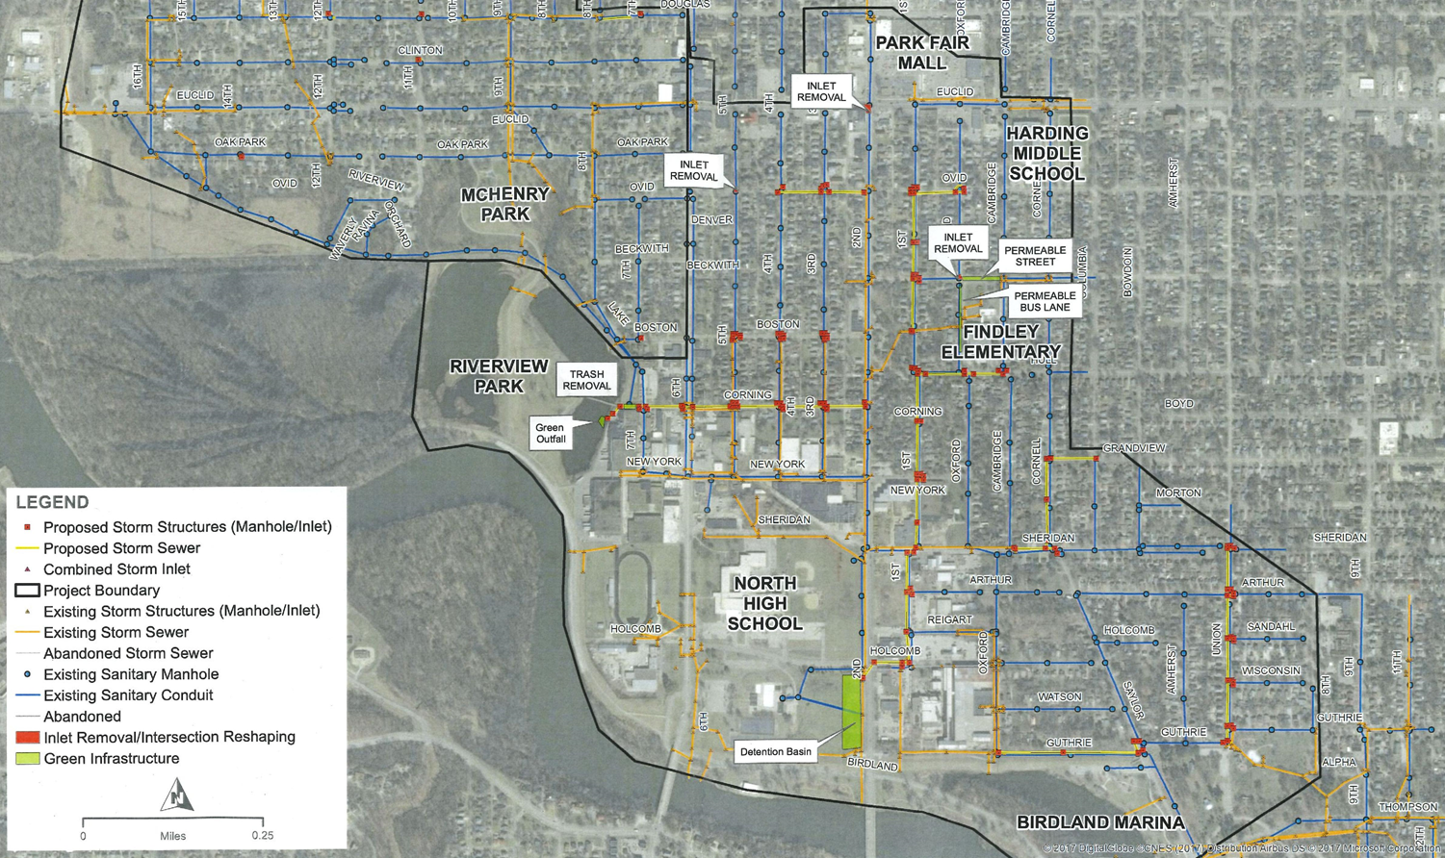
Lower Oak Park/Highland Park
29

Slide 30
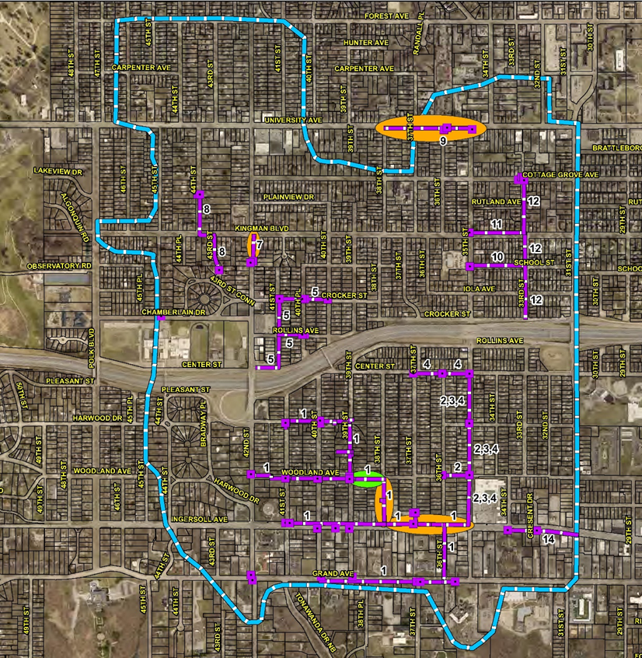
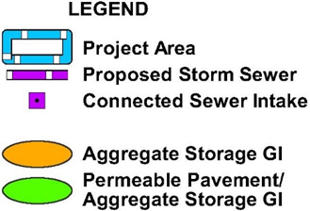
Western Ingersoll Run Sewer Separation

Slide 31
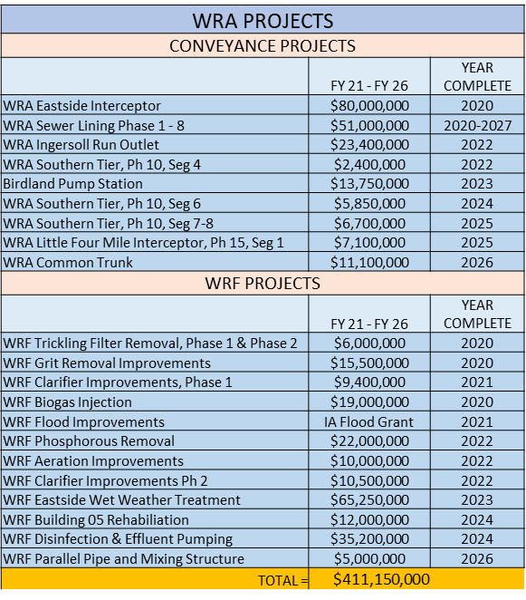
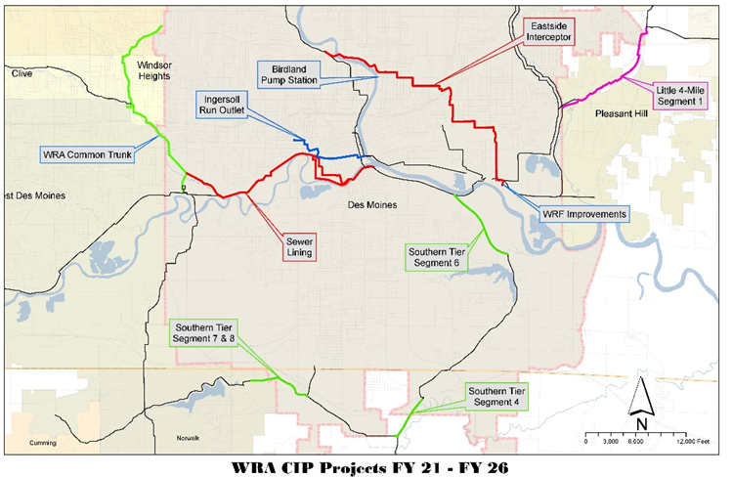
WRA Board Approved CIP Projects
The City of Des Moines share of these projects is approximately only 50% of cost shown. The actual allocation is based on total 3-year average flows and will change each year.
31

Slide 32
32

Slide 33
Summary
Long Term Control Plan (separation projects) and WRA projects will be significant drivers on system rates
$12 million in sewer lining and repair projects to extend life of infrastructure and reduce inflow and infiltration
$63 million remaining for City separation projects through FY2023.
Added equipment replacement fund to normalize annual funding for equipment.
Rates adopted through FY2022 (volume per 1,000 gal):
FY20 - $7.49 FY21 - $7.71 FY22 - $7.94
33

Slide 34
Questions/Comments

